Slide 1
API-313M Review Session 3: Visualization
Yang LI
2022-02-11

Slide 2
Outline
What to convey through visualization
Pipeline to visualize X-space
Extension materials

Slide 3
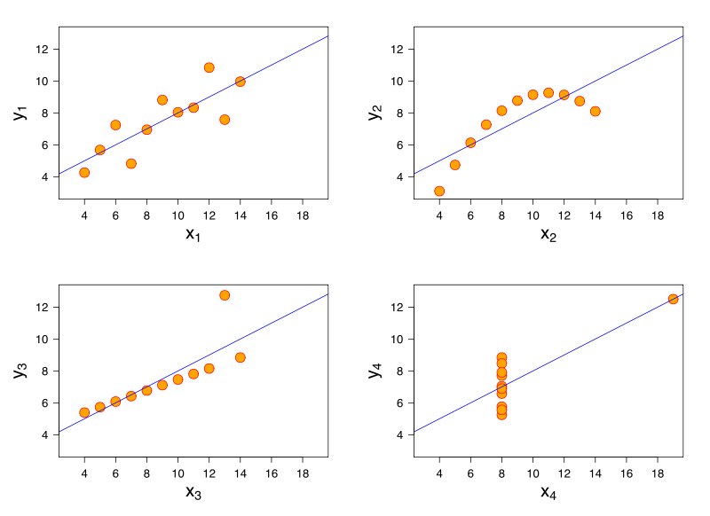
Why visualize the data?
You may never know some facts until you see the data

Slide 4
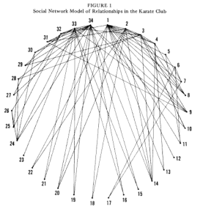
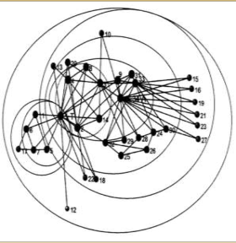
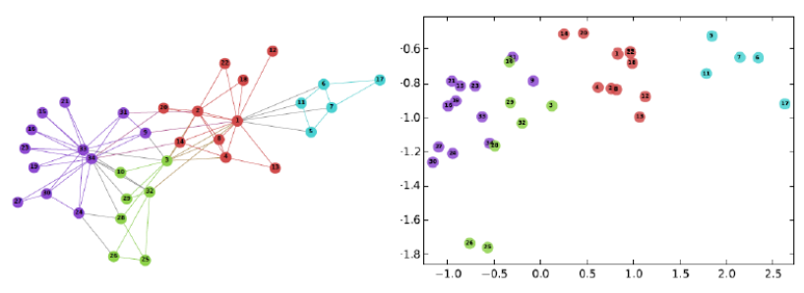
Why visualize the data?
You may never know some facts until you see the data
A good visualization enhance the understanding
Zachary (1977)
White & Harary (2001)
Perozzi, Bryan, et al (2014)

Slide 5
Focus on featured viz in Economic Complexity
Network visualization of X-spaces
UMAP visualization of X-spaces
Treemaps
Geographical Maps
General R visualization for various graphs could be learned at: https://www.r-graph-gallery.com/

Slide 6
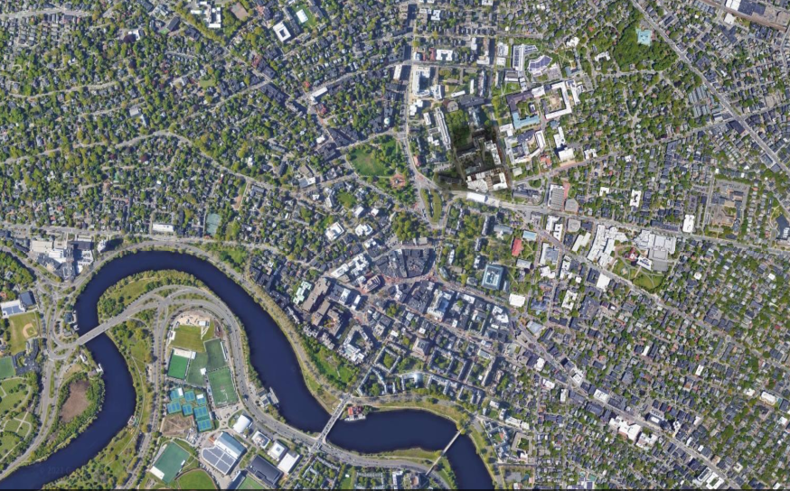
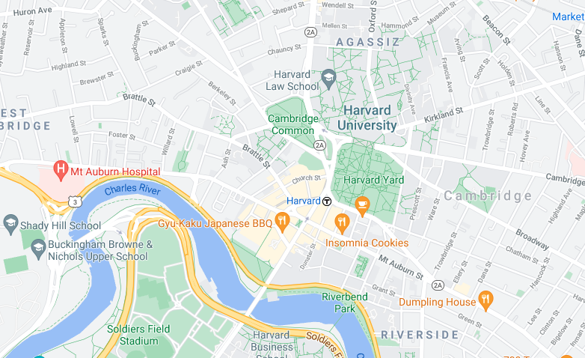
Visualizing X-spaces as drawing a map
Use meaningful symbols to
Preserve the critical entities and relation/locations in space
Simplify the unnecessary part

Slide 7
Input data
E_{cp}/R_{cp}/M_{cp}: value/RCA/presence of region-products
Proximity matrix: relatedness between entities
Feature of entities (products/industries/occupations/etc.):
Classification
Communities/clusters
PCI/ubiquity/etc.
Other statistics

Slide 8
Node elements for representation
Location of Nodes
Color of Nodes
(inc. alpha channel)
A
Shapes of Nodes
Labels of Nodes
Size of Nodes
B

Slide 9
Edges are less used in representation
But it influence the aesthetics of network visualization greatly
A
Labels on Edges
Thickness of Edges
Color of Edge
Directed Edges
Shape of Edges

Slide 10
Pipeline to visualize X-space
Data collection and metric calculation (pre-sessions)
Extract the informative part of relation
Layout generation
(optional) cluster generation
Mapping desired property to visual elements
Whole space
Portfolio of regions

Slide 11
Now get your hands dirty!
https://github.com/complexly/review3_api313m/

Slide 12
Extension materials
Alternative choices in the viz pipeline
Other transformations
Transform raw variable: log/pmi/binarization/etc.
(Dis)similarity metric: Euclidean/cosine/correlation/L*/divergence/…
Backbone extraction+layout algorithm:
KNN
UMAP/Tsne
Other dimension reduction/manifold learning algorithm

Slide 13
Extension materials
Alternative choices in the viz pipeline
Clustering tools:
other community detection algorithm such as infomap/walktrap/etc.
Dimension reduction + clustering algorithm
Plotting interface:
Gephi
Cytoscape
D3 and other javascript based libraries
Interfaces available to transform igraph object: vizNetwork, networkD3, D3network,etc

